Slide 1

SPANISH REAL ESTATE ANALYSIS
ADEI 2024-2025
Joan Marc Coll, Guillem Gaya, Dimas Noguera and Ada Peña

Slide 2


Data Source
1000 instances
24 variables

Slide 3
Data Description
website
url
reference
country
province
location
title
description
price
operation
property_type
rooms
baths
area
floor
elevator
outside
floor.1
images
latitude
longitude
dealer
dealer_url
dealer_is_professional

Slide 4
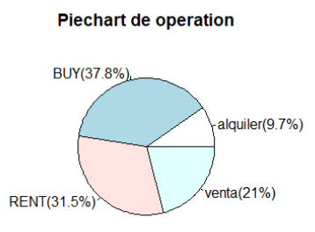
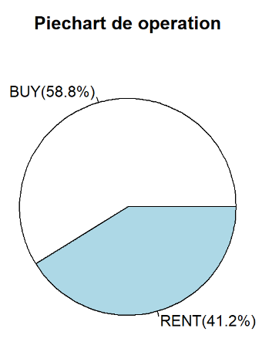
Data Cleaning & Preprocessing:
Data renaming

Slide 5
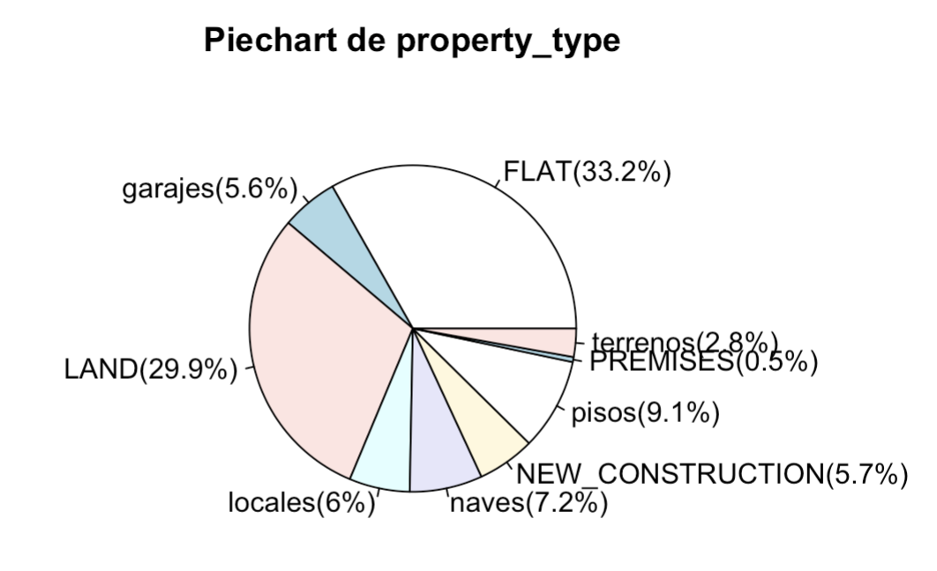
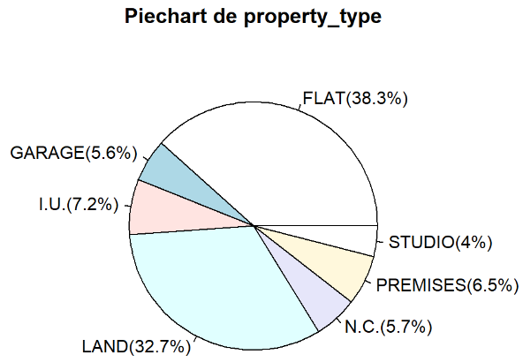
Data Cleaning & Preprocessing:
Data renaming

Slide 6
Data Cleaning & Preprocessing:
Handling missing data
Erased columns:
elevator (100% N/A values)
outside (100% N/A values)
floor (94,7% N/A values)
floor.1 (94,7% N/A values)
Non-random missings
rooms: N/A → 0
baths: N/A → 0
Random missing
KNN algorithm
area
prices

Slide 7
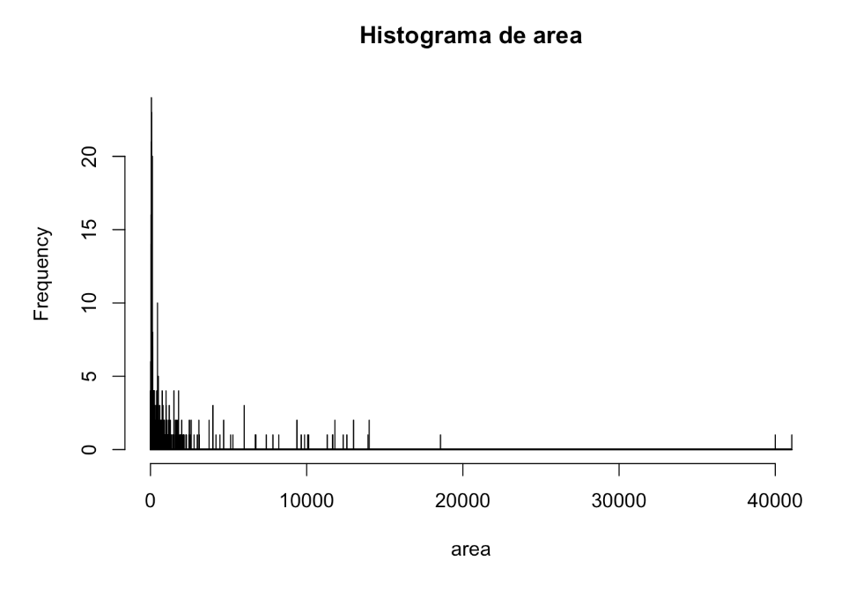
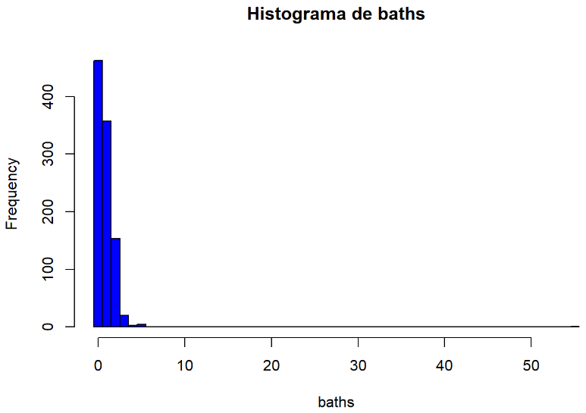
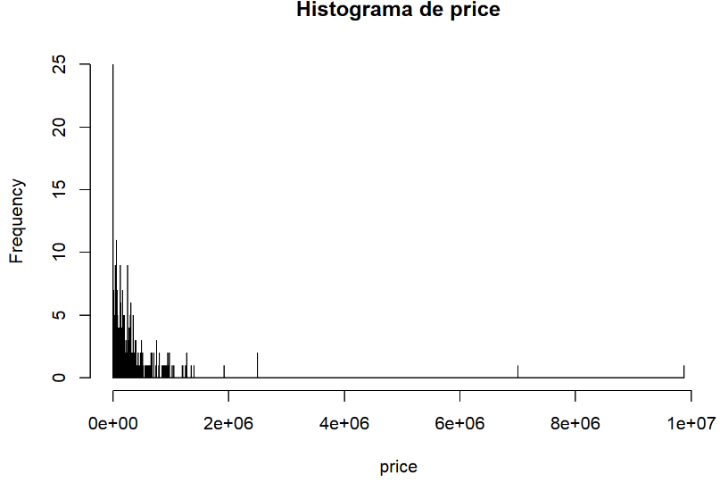
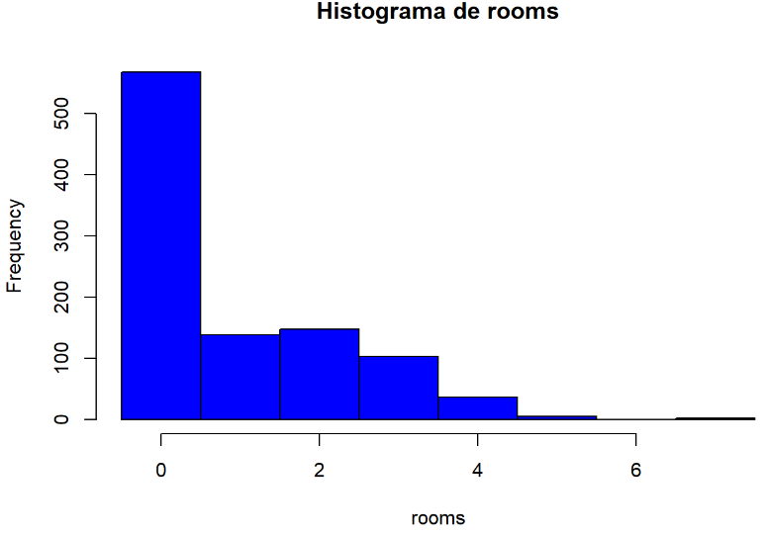
Resulting Data

Slide 8
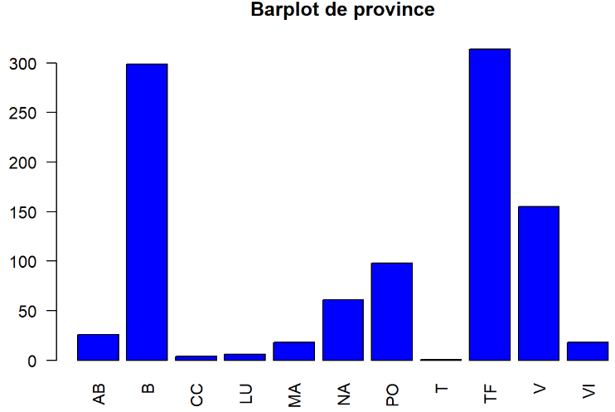
Resulting Data

Slide 9
Modeling: Subsetting
Why?
Ensures more cohesive analysis.
Avoids skewness caused by mixed property types (e.g., LAND, FLAT) and operations (RENT, SALE).
Enables targeted insights on rental price drivers for flats.

Slide 10
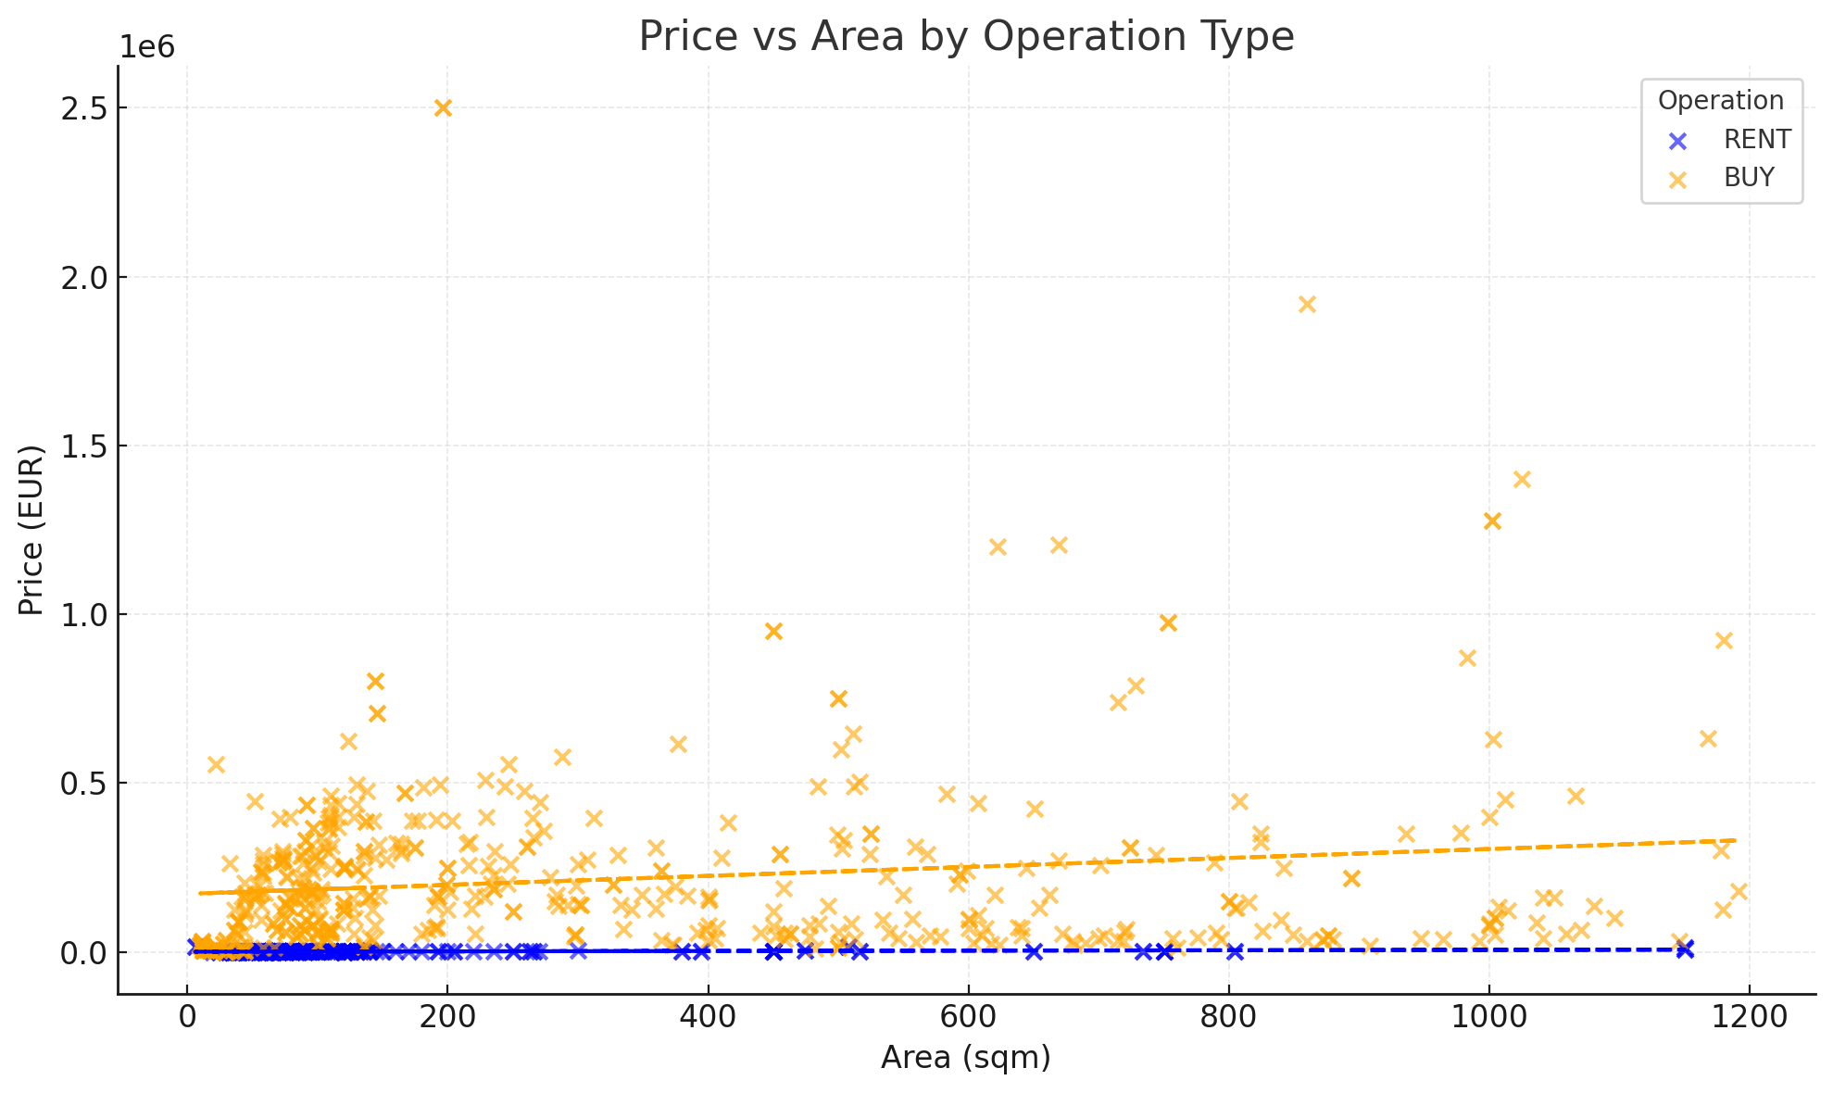
Modeling: Subsetting

Slide 11
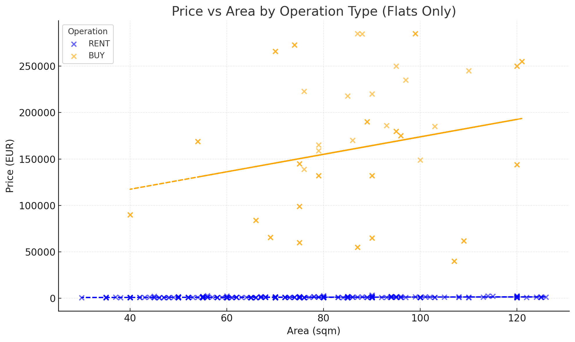
Modeling: Subsetting

Slide 12
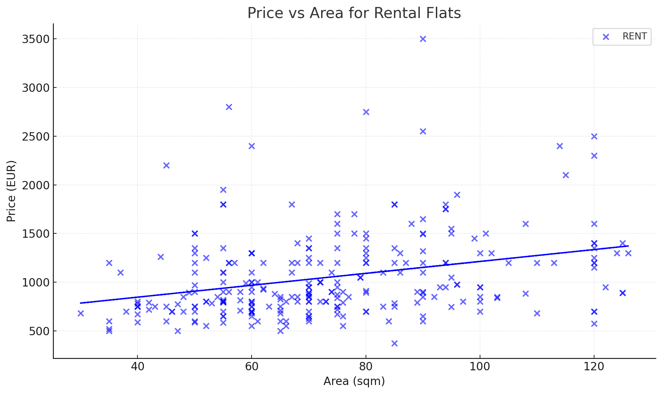
Modeling: Subsetting

Slide 13
Modeling: Numerical Linear Regression Models
Model | Formula | Residual Standard Error (RSE) | Variance Explained R2
price ~ Null | price = 1237.29 | 1281 | 0%
price ~ rooms | price = 412.46 + 439.81 ⋅ rooms | 1218 | 9.9%
price ~ baths | price = 1152.95 + 54.45 ⋅ baths | 1271 | 1.8%
price ~ area | price = 15.46 ⋅ area | 874 | 53.5%
price ~ area + rooms + baths | price = 18.26 ⋅ area - 308.17 ⋅ rooms | 848 | 56.6%

Slide 14
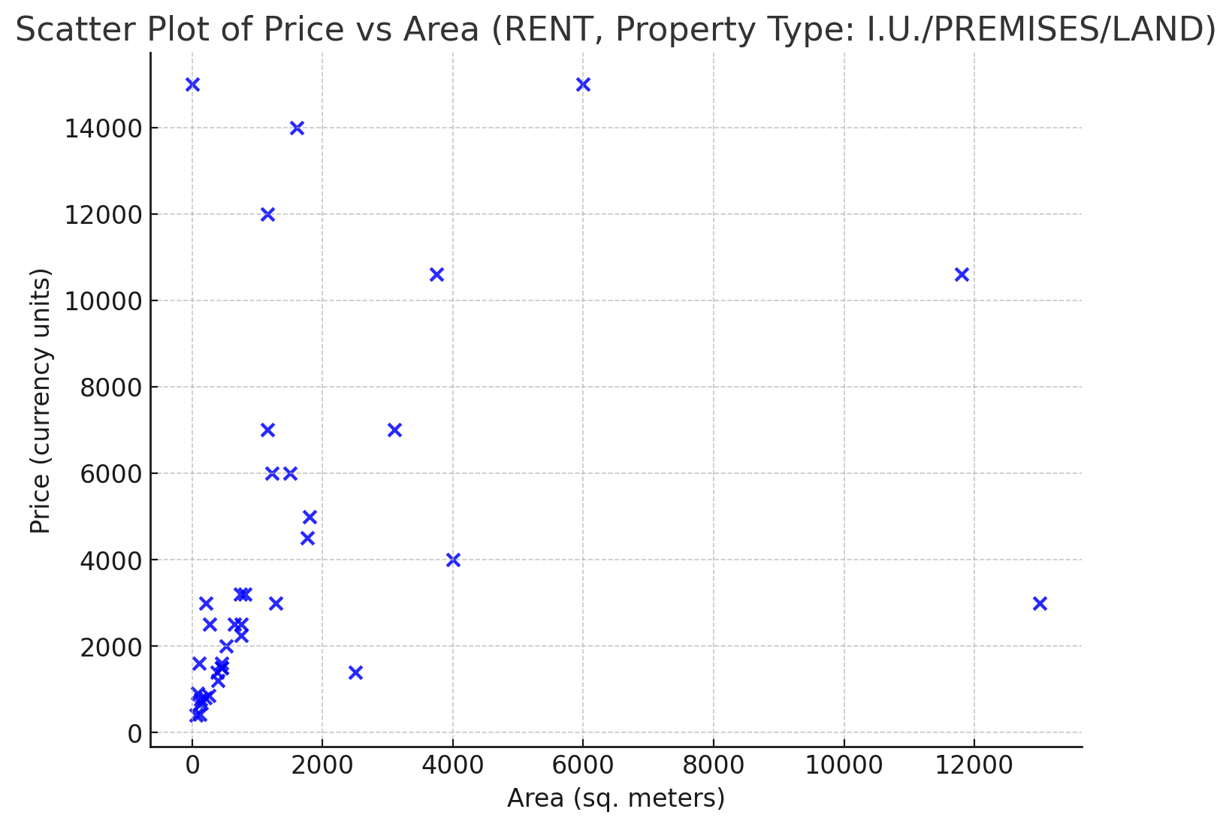
Modeling: Categorical Linear Regression Models
Model | Formula | Residual Standard Error (RSE) | Variance Explained R2
price ~ area | price=10⋅area | 950 | 60%

Slide 15
Modeling: Categorical Linear Regression Models
 | Property Type | RSE/R2 | Property Type * Interaction | RSE/R2 | Property Type + Interaction | RSE/R2
Base Level | 1200 | 1280 / 30% | 1000 + 15 ⋅ area | 890 / 65% | 1100 + 12 ⋅ area | 950 / 60%
LAND | 1500 | 1260 / 32% | 1300 + 17 ⋅ area | 870 / 66% | 1300 + 12 ⋅ area | 940 / 59%
PREMISES | 1700 | 1270 / 29% | 1500 + 14 ⋅ area | 880 / 64% | 1500 + 12 ⋅ area | 950 / 60%
I.U. | 1900 | 1250 / 33% | 1700 + 20 ⋅ area | 850 / 68% | 1700 + 12 ⋅ area | 940 / 59%

Slide 16
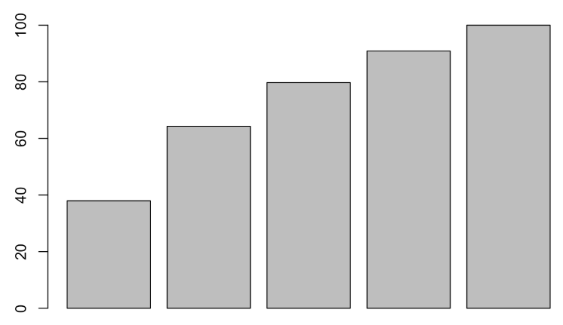
Principal Component Analysis (PCA)
PC1 strongly influenced by price and area.
PC2 has high loadings for rooms and baths.
PC3 mainly highlights images
PC1
PC2
PC3
PC4
PC5

Slide 17
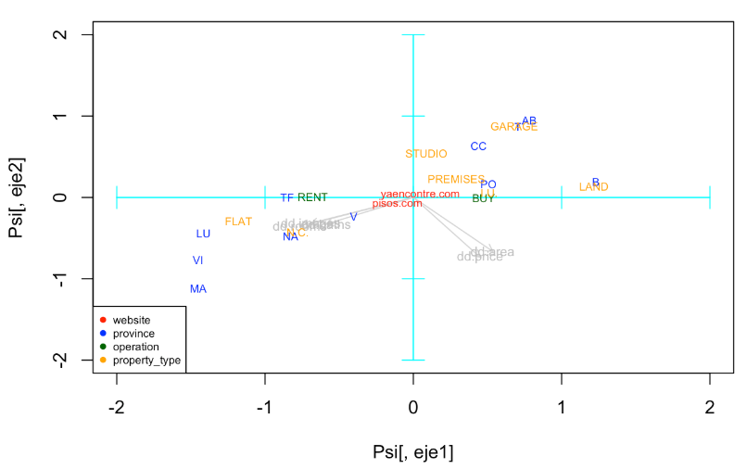
Biplot

Slide 18
Biplot

Slide 19
Biplot

Slide 20
Biplot

Slide 21
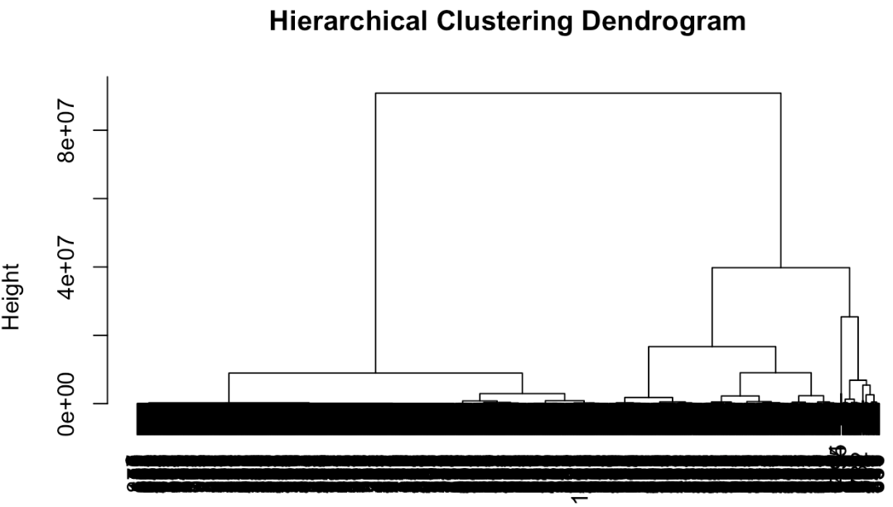
Clustering

Slide 22
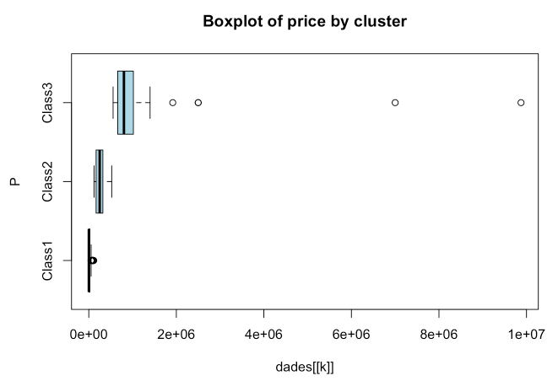
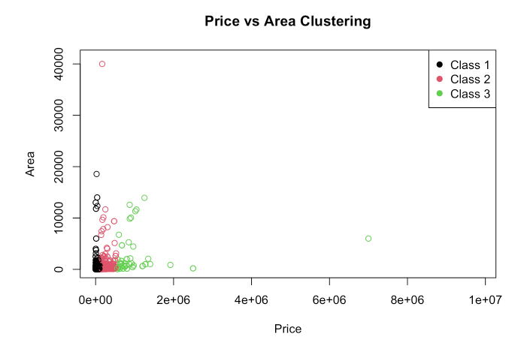
Clustering

Slide 23
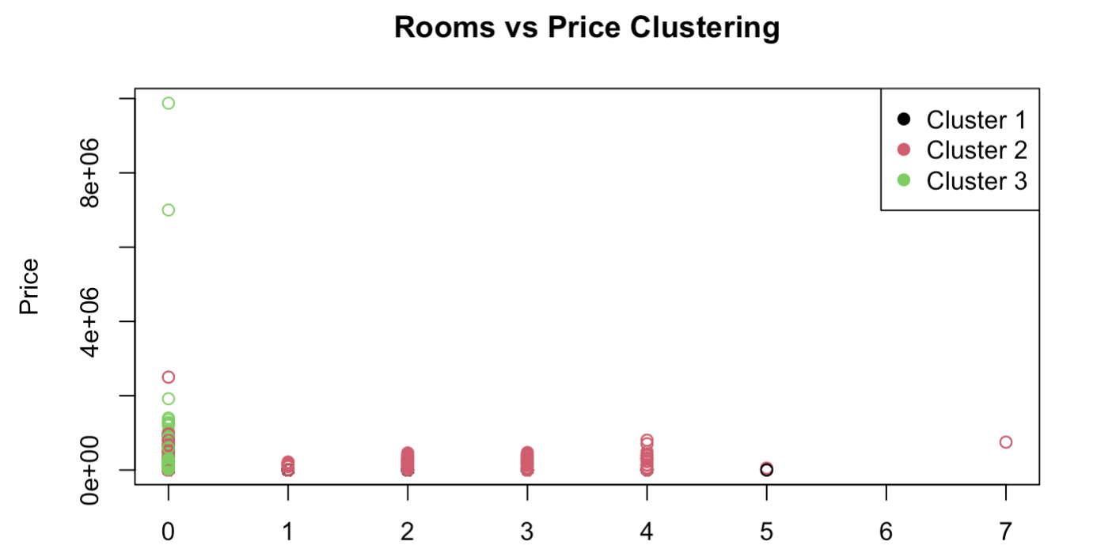
Clustering

Slide 24
Profiling
Results
Cluster 1
Average Price: 10.000€
Average Area: 50 m²
Small apartments or studios
Cluster 2
Average Price: 50.000€
Average Area: 150 m²
Medium-sized properties aimed at families
Cluster 3
Average Price: 500.000€
Average Area: 300 m²
Exclusive properties

Slide 25
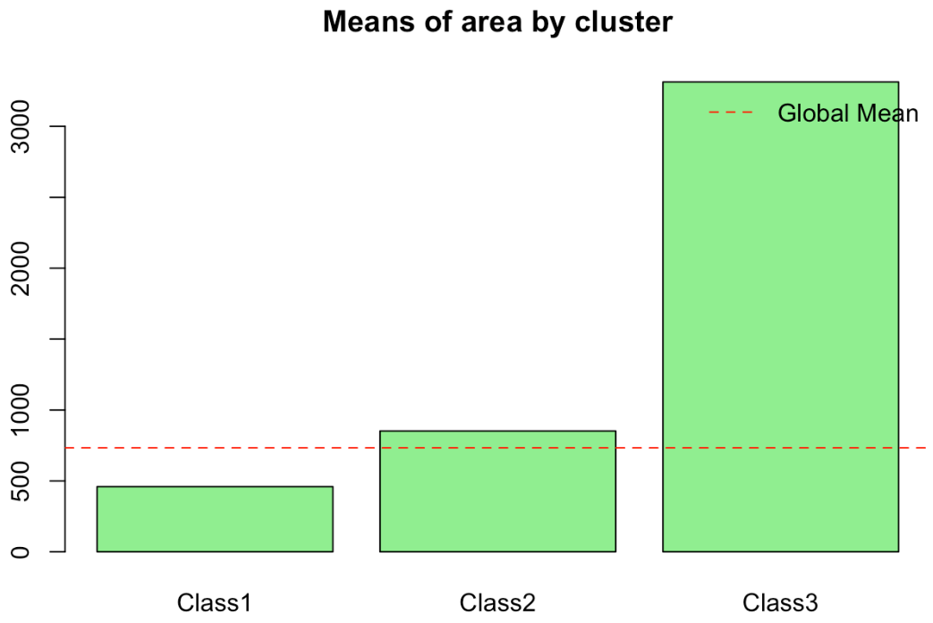
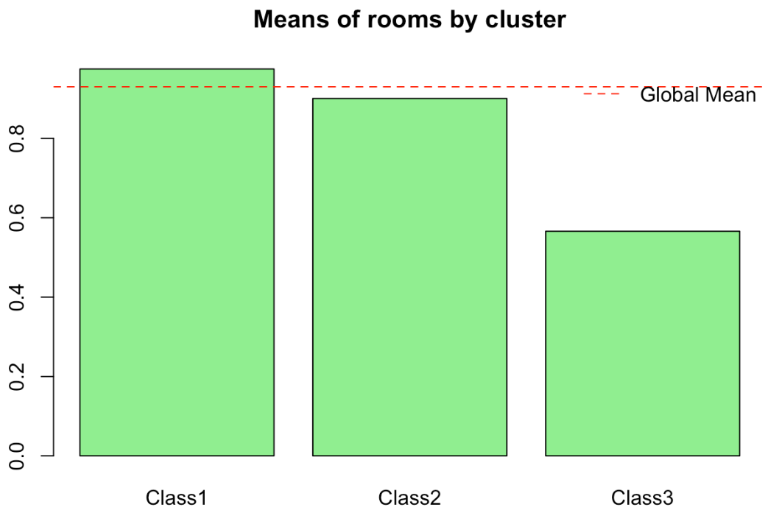
Profiling

Slide 26
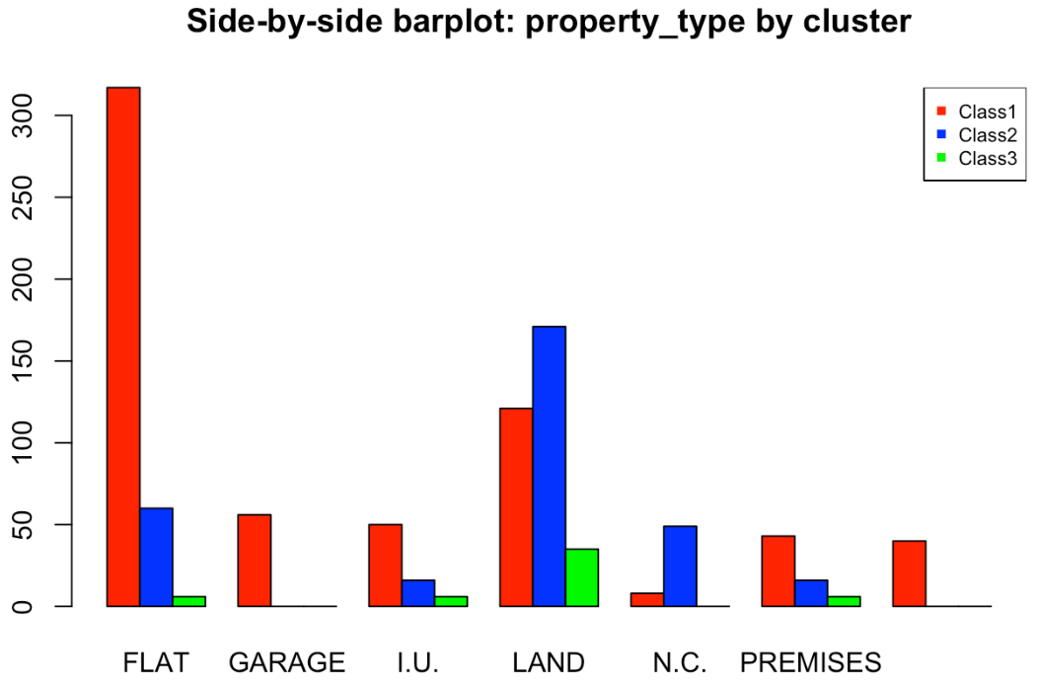
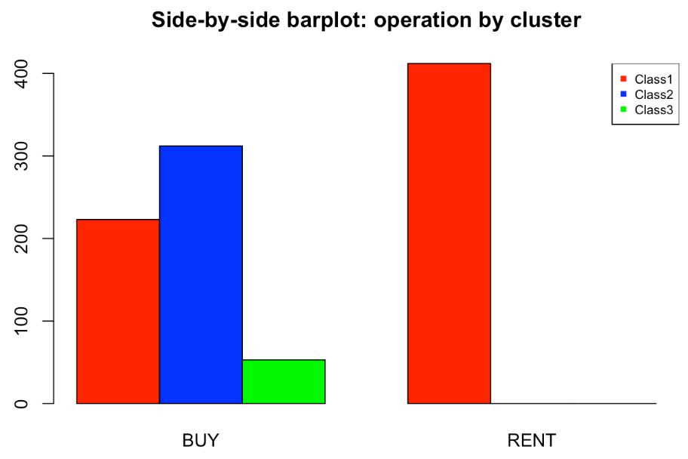
Profiling
STUDIO

Slide 27
Conclusions
Cluster 1
Campaigns for students
People who can’t afford to buy a property
Cluster 2
Families’ medium-sized homes
Cluster 3
Premium customers
Lands, premises…

Slide 28
THANK YOU FOR YOUR ATTENTION

